Slide 1

2D Brain Tumor MRI Segmentation Using U-Net

Slide 2
Executive Summary
Developed a deep learning model to segment brain tumors in 2D MRI scans.
Used a U-Net architecture for pixel-wise segmentation accuracy.
Dataset from Kaggle with 4,715 annotated images (grayscale + binary masks).
Preprocessed and augmented data to improve model generalization.
Achieved strong results on the test set: → Dice Coefficient: 0.979, IoU: 0.959 → Accuracy: 99.77%, Precision: 98.3%, Recall: 97.5%

Slide 3
Introduction
Brain tumors are life-threatening and require accurate diagnosis.
MRI is widely used for non-invasive brain imaging.
Manual segmentation of MRI scans is time-consuming and error-prone.
Deep learning models like U-Net automate tumor segmentation with high precision.
This project aims to build a U-Net-based segmentation model to detect tumors in 2D brain MRI slices.

Slide 4
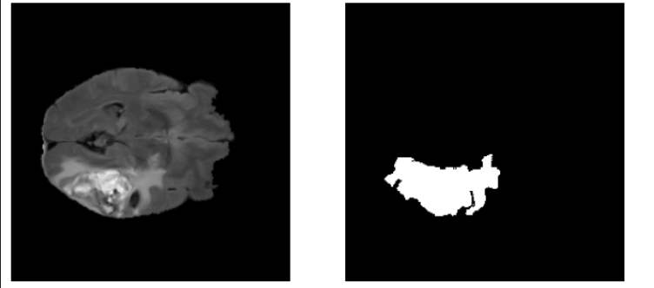
Dataset Description
Source: Kaggle - Brain 2D MRI Images and Mask
Total samples: 4715 2D MRI slices with corresponding masks
Image resolution: 240×240 (resized to 256×256)
Grayscale input images, binary tumor masks
Not all images contain tumors
Dataset split:
Training: 3017 images
Validation: 943 images
Testing: 755 images
Sampe of the original MRI scan with its mask

Slide 5
Data Preprocessing
Converted original HDF5 data into PNG format
Resized all images and masks to 256×256 pixels
Normalized image pixel values to the [0, 1] range
Ensured masks are binary (0 or 1)
Applied data augmentation techniques:
Rotation, shifting, and scaling
Split dataset into train / validation / test

Slide 6
Model Architecture – U-Net
Used U-Net architecture: a CNN designed for biomedical segmentation
Consists of:
Encoder (contracting path): feature extraction via convolution and pooling
Decoder (expanding path): upsampling + concatenation with encoder layers
Allows precise localization + semantic segmentation
Custom loss function:
Dice Loss
Model compiled with:
Nadam optimizer (learning rate: 1 × 10^−7)
Evaluation metrics: Dice, IoU

Slide 7
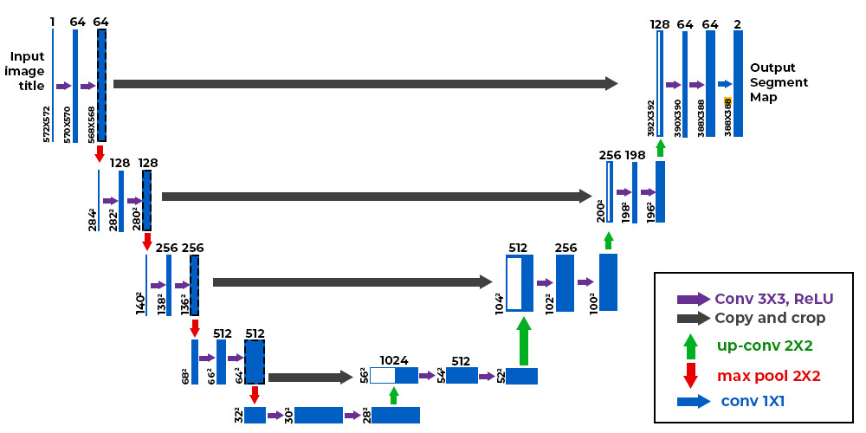
Model Architecture – U-Net

Slide 8
Model Evaluation
Key Metrics on Test Set:
Dice Coefficient: 0.9789
IoU Score: 0.9588
Accuracy: 0.9977
Precision: 0.9827
Recall: 0.9753
F1 Score: 0.9789
Model Generalization:
No signs of overfitting during training.
Training and validation losses followed consistent downward trends.
The model performed well on unseen data.

Slide 9
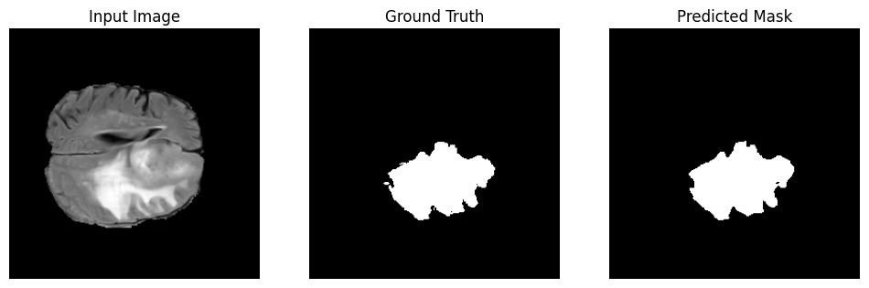
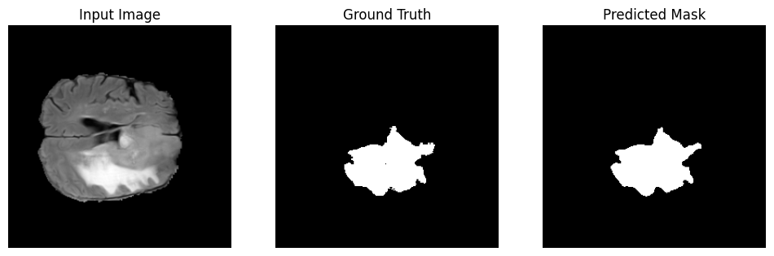
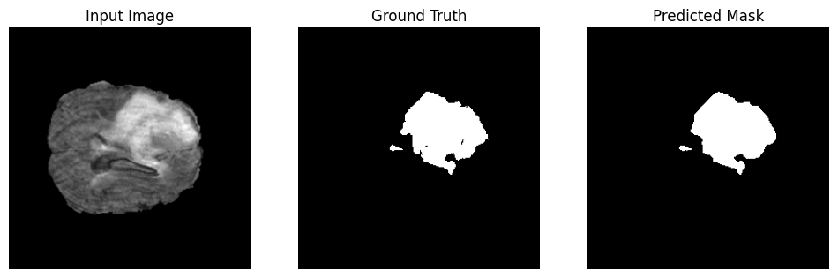
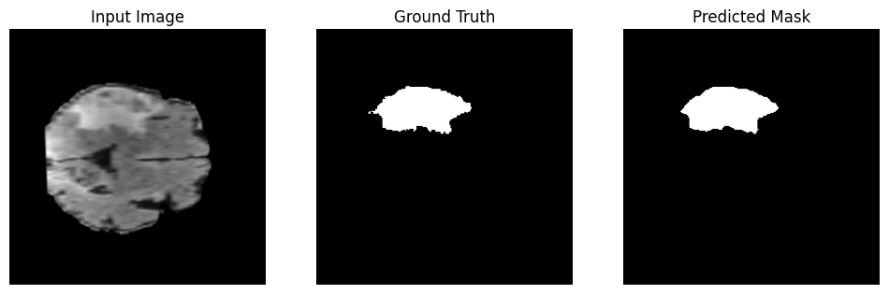
Visual results on unseen data

Slide 10
Conclusion
Summary:
Successfully built a U-Net model for 2D brain tumor segmentation.
Achieved strong results on the test set with high Dice and IoU scores.
The model generalized well across training, validation, and test sets.
Key Takeaways:
Deep learning can significantly reduce the burden of manual medical image segmentation.
U-Net is effective for biomedical segmentation tasks due to its skip connections and encoder-decoder design.
Proper preprocessing and clean data handling are critical for success in medical imaging projects.
Future Work:
Extend to 3D MRI segmentation or multi-class tumor classification.
Improve model robustness on diverse datasets.

Slide 11
Thank You
Project by: Moamen Mohamed Ahmed Hassan
Email: moamengaber2002@gmail.com
GitHub: github.com/MoamenGaber2/brain_mri_2d_segmentation

